Slide 1
Assignment 1 Clarification

Slide 2
Recursive Versus Nonrecursive
Model 2 is recursive.
The B matrix can be lower triangular depending on how we label the endogenous variables.
The ψ matrix is a diagonal matrix.

Slide 3
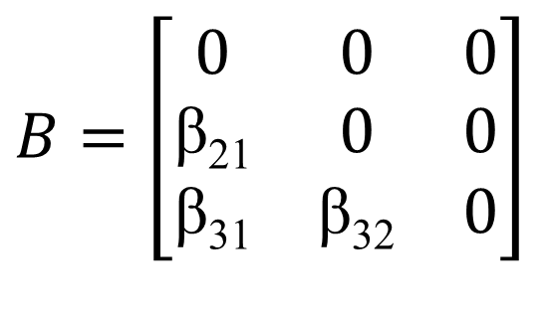
Recursive Versus Nonrecursive
γ₂₁
β₃₁
X₁
Y₂
Y₃
γ₂₂
β₂₁
β₃₂
X₂
Y₁
$B=\left[\begin{matrix}0 & 0 & 0 \\ \text{β}\text{21} & 0 & 0 \\ \text{β}\text{31} & \text{β}\text{32} & 0\end{matrix}\right]$
γ₁₂
γ₃₂
X₃

Slide 4
Recursive Versus Nonrecursive
There is unidirectional causal flow.
The B matrix is lower triangular.
The disturbances are uncorrelated.
The ψ matrix is a diagonal matrix.

Slide 5
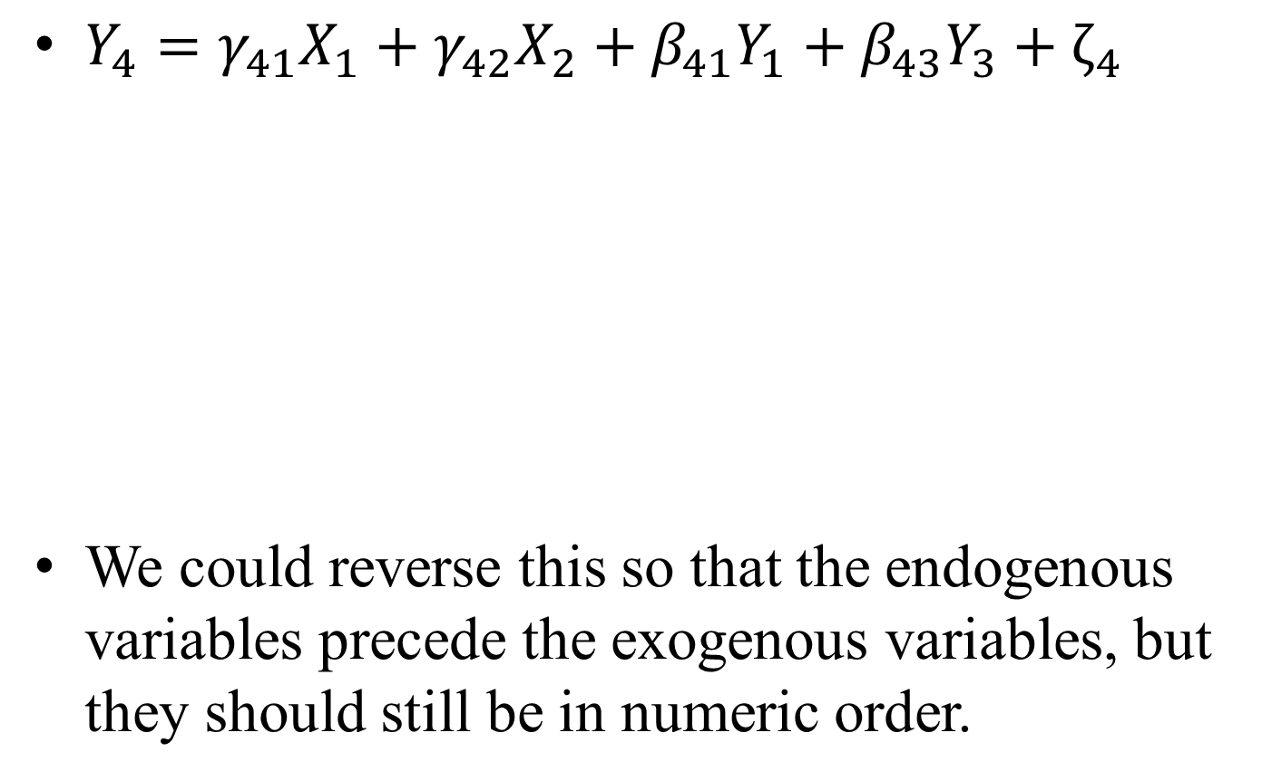
Writing Equations
$Y_{4}=γ_{41}X_{1}+γ_{42}X_{2}+β_{41}Y_{1}+β_{43}Y_{3}+ζ_{4}$
We could reverse this so that the endogenous variables precede the exogenous variables, but they should still be in numeric order.
Exogenous Variables in Numeric Order
Endogenous Variables in Numeric Order

Slide 6

Model 3
Write $Γ=\left[\begin{matrix}γ_{11} \\ 0 \\ \begin{matrix}0 \\ 0\end{matrix}\end{matrix}\right]$, not $Γ=γ_{11}$.

